Slide 1

Multi Dimensional Arrays
Prof. Dr. Alp KUT
Asst. Prof. Dr. Derya BİRANT

Slide 2
OUTLINE
Arrays
  One Dimensional Arrays
  Two Dimensional Arrays
  Multi Dimensional Arrays
Matrix Operations
Examples

Slide 3
Arrays
An array is a data structure consisting of a group of elements that are accessed by indexing.
All of the array elements must be of the same type .
An array can be
  one-dimensional,
  two-dimensional, or
  multi-dimensional

Slide 4
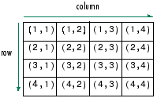
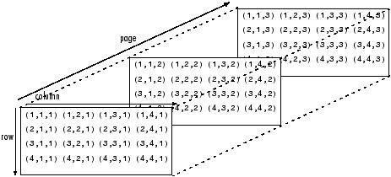
Arrays
One-dimensional Arrays
  row dimension
Two-dimensional Arrays:
  row dimension
  column dimension
Multi-dimensional Arrays
  row dimension
  column dimension
  third dimension
  ...

Slide 5


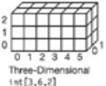
Arrays
0
1
2
3
4
One-dimensional Arrays
Two-dimensional Arrays
Multi-dimensional Arrays
0
1
2
0
1
2

Slide 6
One Dimensional Arrays
An array that consists of n elements
0
1
2
...
n-1
Element 1
Element 2
Element 3
...
Element n

Slide 7
One Dimensional Arrays
Example:
This array contains 5 integer elements (from a[0] to a[4]).
int[] a = new int[5];
a[0] = 3;
a[1] = 5;
a[2] = 8;
a[3] = 10;
a[4] = 12;
3
5
8
10
12

Slide 8
One Dimensional Arrays
Declaration of an empty array
int[] a = new int[5];
Initialization of an array upon declaration
int[] a = new int[] { 1, 3, 5, 7, 9 };
Initialization of an array upon declaration
int[] a = { 1, 3, 5, 7, 9 };

Slide 9
Two Dimensional Arrays
An array that consists of n rows and m columns
contains n*m elements
0
1
2
...
n-1
Element (0,0) | Element (0,1) | ... | Element (0,m-1)
Element (1,0) | Element (1,1) | ... | Element (1,m-1)
... | ... | ... | ...
Element (n-1,0) | Element (n-1,1) | ... | Element (n-1,m-1)
0 | 1 | ... | m-1

Slide 10
Two Dimensional Arrays
Assume that chess board
Chess
0,0
0,1
0,2
0,3
0,4
0,5
0,6
0,7
1,0
1,1
1,2
1,3
1,4
1,5
1,6
1,7
2,0
2,1
2,2
2,3
2,4
2,5
2,6
2,7
3,0
3,1
3,2
3,3
3,4
3,5
3,6
3,7
Chess(5,2)
4,0
4,1
4,2
4,3
4,4
4,5
4,6
4,7
Chess(2,6)
5,0
5,1
5,2
5,3
5,4
5,5
5,6
5,7
6,0
6,1
6,2
6,3
6,4
6,5
6,6
6,7
7,0
7,1
7,2
7,3
7,4
7,5
7,6
7,7

Slide 11
Two Dimensional Arrays
Example:
0 | 0 | 0
0 | 0 | 0
int[,] a = new int[2,3];
a[0,1] = 3;
a[1,2] = 5;
a[1,0] = 8;
0 | 3 | 0
0 | 0 | 0
0 | 3 | 0
0 | 0 | 5
0 | 3 | 0
8 | 0 | 5

Slide 12
Two Dimensional Arrays
Example:
This array contains 6 integers elements.
int[,] a = new int[2,3];
a[0,0] = 3;
a[0,1] = 5;
a[0,2] = 8;
a[1,0] = 10;
a[1,1] = 12;
a[1,2] = 14;
a[0,0] | a[0,1] | a[0,2]
a[1,0] | a[1,1] | a[1,2]
3 | 5 | 8
10 | 12 | 14

Slide 13
Two Dimensional Arrays
Example:
This array contains 8 string elements.
string[,] s = new string[4,2];
s[0,0] = ″Ali″;
s[0,1] = ″Taş″;
s[1,0] = ″Ayşe″;
s[1,1] = ″Kaya″;
s[2,0] = ″Ahmet″;
s[2,1] = ″Yaprak″;
s[3,0] = ″Mehmet″;
s[3,1] = ″Sakar″;
Ali | Taş
Ayşe | Kaya
Ahmet | Yaprak
Mehmet | Sakar

Slide 14
Two Dimensional Arrays
Initializing the array upon declaration
Example:
int[,] a = new int[,] {{1,2}, {3,4}, {5,6}, {7,8}};
1 | 2
3 | 4
5 | 6
7 | 8

Slide 15
Example 1
Write a program that finds the name(s) of the person(s) whose surname is “Kaya”.
Can | Taş
Ali | Kaya
Aslı | Ak
Lale | Kaya
Yeliz | Seçkin
string[,] a = new string[,] {{"Can","Taş"},
{"Ali","Kaya"},
{"Aslı","Ak"},
{"Lale","Kaya"},
{"Yeliz","Seçkin"}};
for (int i = 0; i < a.GetLength(0); i++)
if (a[i,1] == "Kaya")
Console.WriteLine(a[i,0]);

Slide 16
Example 2
Write a program that finds the name(s) of the person(s) who is female and lives in Izmir.
John | M | İzmir
Sally | F | İstanbul
Tom | M | Ankara
Mary | F | İzmir
Jane | F | Antalya
string[,] a = new string[,] {{"John","M","İzmir"},
{"Sally","F","İstanbul"},
{"Tom","M", "Ankara"},
{"Mary","F","İzmir"},
{"Jane","F","Antalya"}};
for (int i = 0; i < a.GetLength(0); i++)
if ((a[i,1] == "F") & (a[i,2] == "İzmir"))
Console.WriteLine(a[i,0]);

Slide 17
Example 3
Write a program that finds how many times a given number is repeated.
Example: input = 1
output = 4
1
1
6
5
6
1
0
8
6
4
6
2
2
7
6
3
2
1
6
8
int[,] a = new int[,] {{1,1}, {1,0}, {6,2}};
int number;
int sayac = 0;
Console.Write("Enter a number: ");
number = Convert.ToInt16(Console.ReadLine());
for (int i = 0; i < a.GetLength(0); i++)
for (int j = 0; j < a.GetLength(1); j++)
if (a[i,j] == number)
sayac = sayac + 1;
Console.WriteLine(sayac);

Slide 18
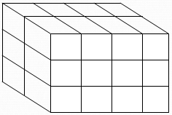
Multi Dimensional Arrays
An array that have more than two dimensions.
a[0,1,1]
a[0,2,1]
a[0,3,1]
a[0,0,1]
a[1,0,1]
a[0,0,0]
a[0,1,0]
a[0,2,0]
a[0,3,0]
a[2,0,1]
a[1,0,0]
a[1,1,0]
a[1,2,0]
a[1,3,0]
a[2,0,0]
a[2,1,0]
a[2,2,0]
a[2,3,0]
int[, ,] a = new int[3, 4, 2];

Slide 19
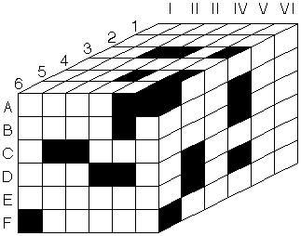
Multi Dimensional Arrays
An array that have more than two dimensions.
int[, ,] cube = new int[6, 6, 6];

Slide 20
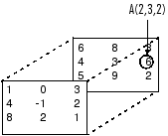
Multi Dimensional Arrays
Example:
int[, ,] A = new int[3, 3, 2];
A[0,0,0] = 1; A[0,0,1] = 6;
A[0,1,0] = 0; A[0,1,1] = 8;
A[0,2,0] = 3; A[0,2,1] = 3;
A[1,0,0] = 4; A[1,0,1] = 4;
A[1,1,0] =-1; A[1,1,1] = 3;
A[1,2,0] = 2; A[1,2,1] = 6;
A[2,0,0] = 8; A[2,0,1] = 5;
A[2,1,0] = 2; A[2,1,1] = 9;
A[2,2,0] = 1; A[2,2,1] = 2;
A(1,2,1)

Slide 21
Multi Dimensional Arrays
Initializing the array upon declaration
Example:
int[,,] array = new int[,,] {{{1,2,3}}, {{4,5,6}}};
Initializing the array without specifying the rank
Example:
int[,,] array ={{{1,2,3}}, {{4, 5, 6}}};

Slide 22
Example 4
Write a program that takes 12 string values from the user, puts them into a three dimensional array that has 3,2, and 2 sizes and prints the element list.
string[,,] array = new string[3,2,2];
for (int i = 0; i < 3;i++ )
for (int j = 0; j < 2; j++)
for (int k = 0; k <2 ; k++)
{
Console.Write("Enter the element of array[" +i+ "," +j+","+k +"]:");
array[i, j, k] = Console.ReadLine();
}
for (int i = 0; i < 3; i++)
for (int j = 0; j < 2; j++)
for (int k = 0; k < 2; k++)
Console.WriteLine("array["+i+","+j+","+k+"] => "+array[i,j,k]);
Console.ReadLine();

Slide 23

Matrix Operations
Addition:
int[,] array1 = new int[,] {{1,3},{1,0},{1,2}};
int[,] array2 = new int[,] {{0,0},{7,5},{2,1}};
int[,] result = new int[,] {{0,0},{0,0},{0,0}};
for (int i = 0; i < 3; i++)
for (int j = 0; j < 2; j++)
result[i,j] = array1[i,j] + array2[i,j];
for (int i = 0; i < 3; i++)
{
for (int j = 0; j < 2; j++)
Console.Write(" " + result[i,j]);
Console.WriteLine();
}

Slide 24
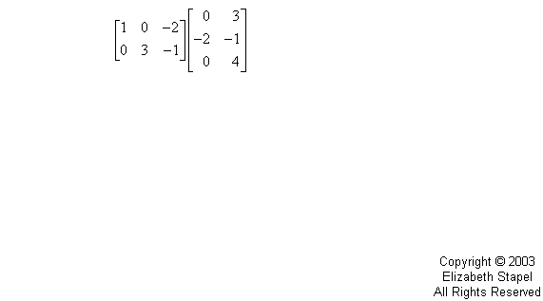
Matrix Operations
Multiplication:

Slide 25

Matrix Operations
Multiplication:
int[,] array1 = new int[,] {{1,0,2},{-1,3,1}};
int[,] array2 = new int[,] {{3,1},{2,1},{1,0}};
int[,] result = new int[,] {{0,0},{0,0}};
int sum = 0;
for (int i = 0; i <2; i++)
{
for (int j = 0; j <2; j++)
{
sum = 0;
for (int k = 0; k < 3; k++)
sum = sum + array1[i, k] * array2[k, j];
result[i, j] = sum;
}
}
for (int i = 0; i < 2; i++)
{
for (int j = 0; j < 2; j++)
Console.Write(" " + result[i,j]);
Console.WriteLine();
}

Slide 26
Matrix Operations
Transpose:
3 | 5
1 | 8
2 | 6
3 | 1 | 2
5 | 8 | 6
int[,] a = new int[,] {{3,5},{1,8},{2,6}};
int[,] trans_a = new int[,]{{0,0,0},{0,0,0}};
for (int i = 0; i < 3; i++)
for (int j = 0; j < 2; j++)
trans_a[j, i] = a[i,j];
for (int i = 0; i < 2; i++)
{
for (int j = 0; j < 3; j++)
Console.Write(" " + trans_a[i,j]);
Console.WriteLine();
}

Slide 27

Matrix Example
Write a function that prints true if given matrix is a diagonal matrix, otherwise false.
A diagonal matrix is a square matrix with all non-diagonal elements equal to 0.
Example:
int[,] a = new int[,] {{1,0,0}, {0,4,0}, {0,0,-3}};
bool flag = true;
for (int i = 0; i < a.GetLength(0) ; i++)
for (int j = 0; j < a.GetLength(1); j++) {
if ((i != j) & (a[i,j] != 0))
flag = false;
if ((i == j) & (a[i,j] == 0))
flag = false;
}
Console.WriteLine(flag);

